Slide 1
Webinaire SensorThings API
Some STA Clients for SensorThings - Brainstorming

Slide 2
Known Viewers
Genesis
STAM
QGIS : https://github.com/AirBreak-UIA/SensorThingsAPI_QGIS-plugin
Grafana : https://grafana.com/grafana/plugins/iosb-sensorthings-datasource/
Geomatys Examind Community
Many ad’hoc deployment (HTML, JS, R shiny): Internet of Water US, BRGM, UMR SAS (cf presentation), BGS
Jupyter Notebook
And this list was only done in an hour…

Slide 3
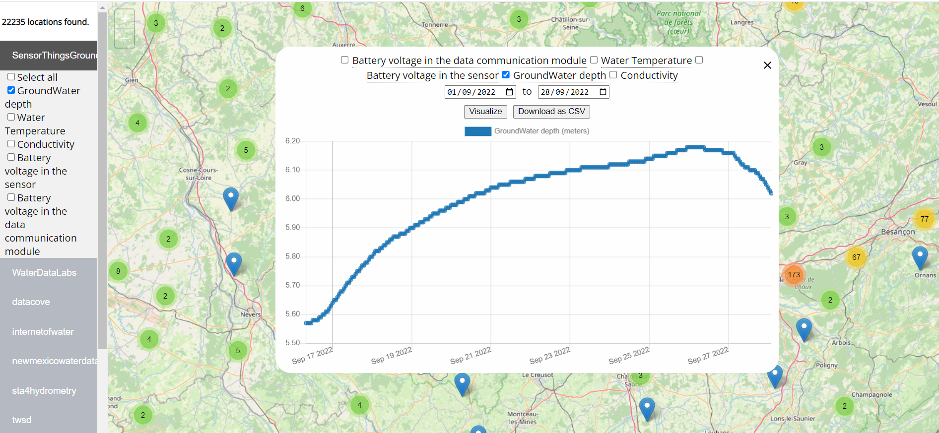
Same endpoint: different viewer
Internet of water US

Slide 4
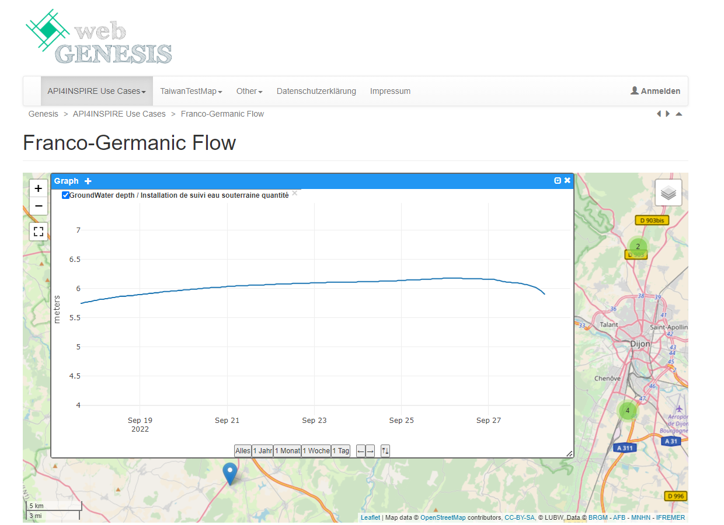
Same endpoint: different viewer
Fraunhofer WebGenesis

Slide 5
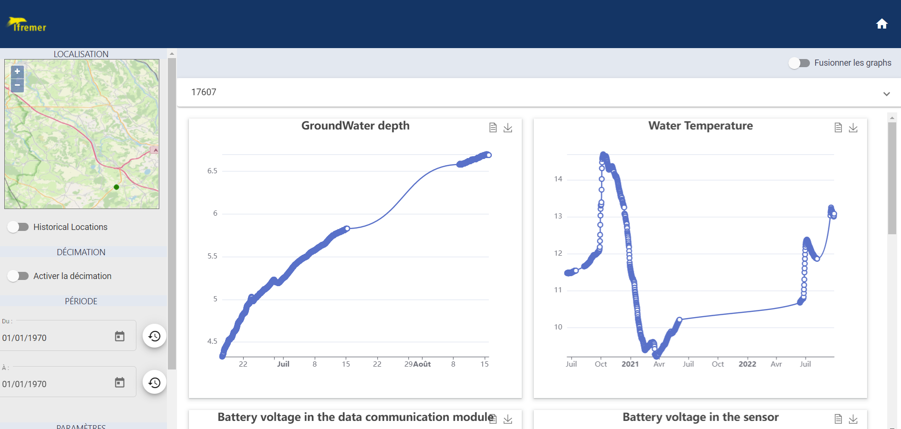
Same endpoint: different viewer
Geomatys Examind Community

Slide 6
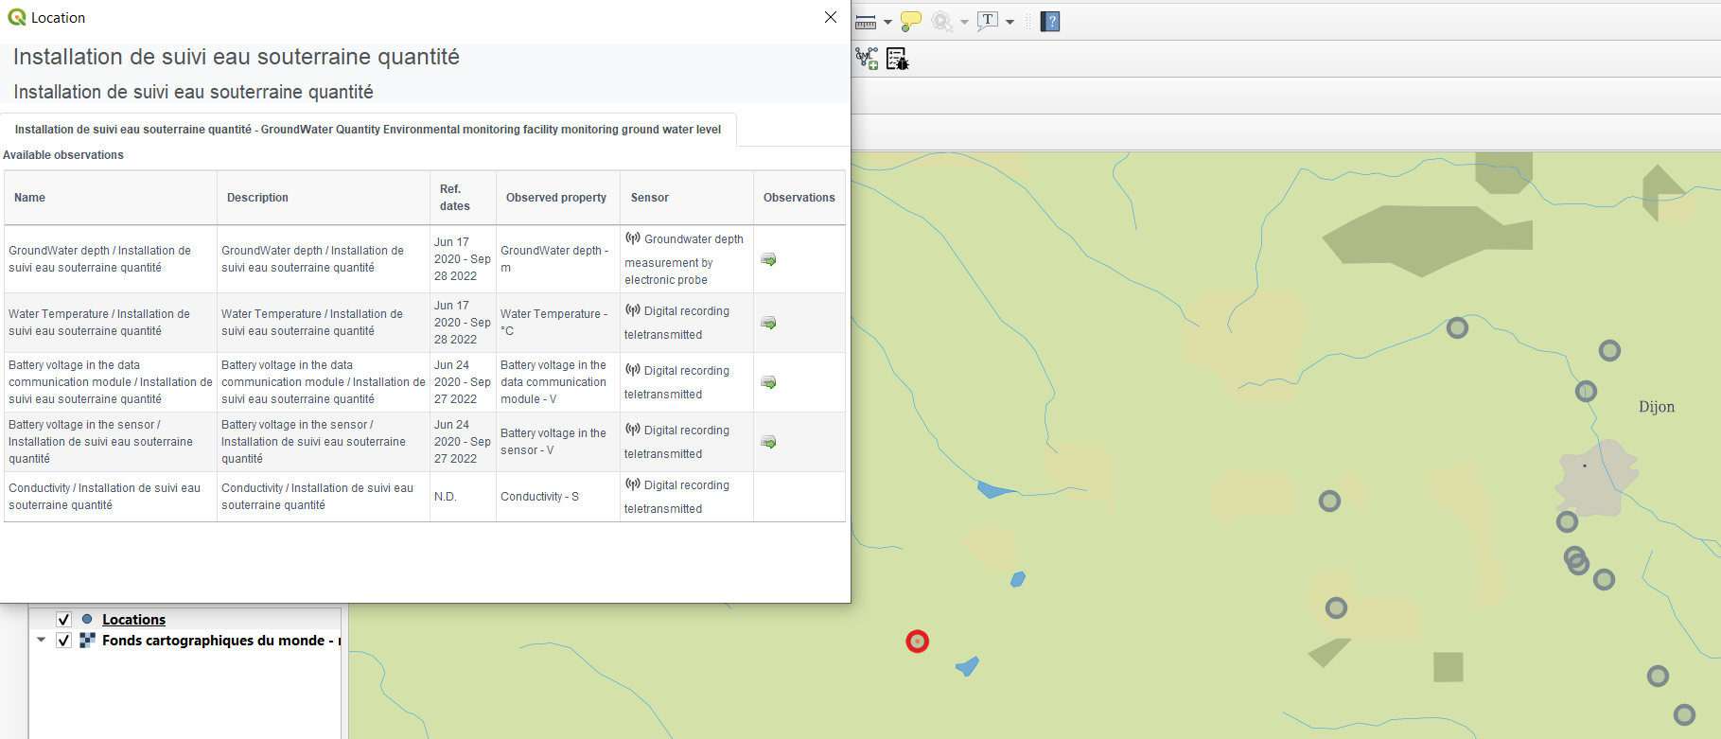
Same endpoint: different viewer
QGIS new ST API plugin

Slide 7
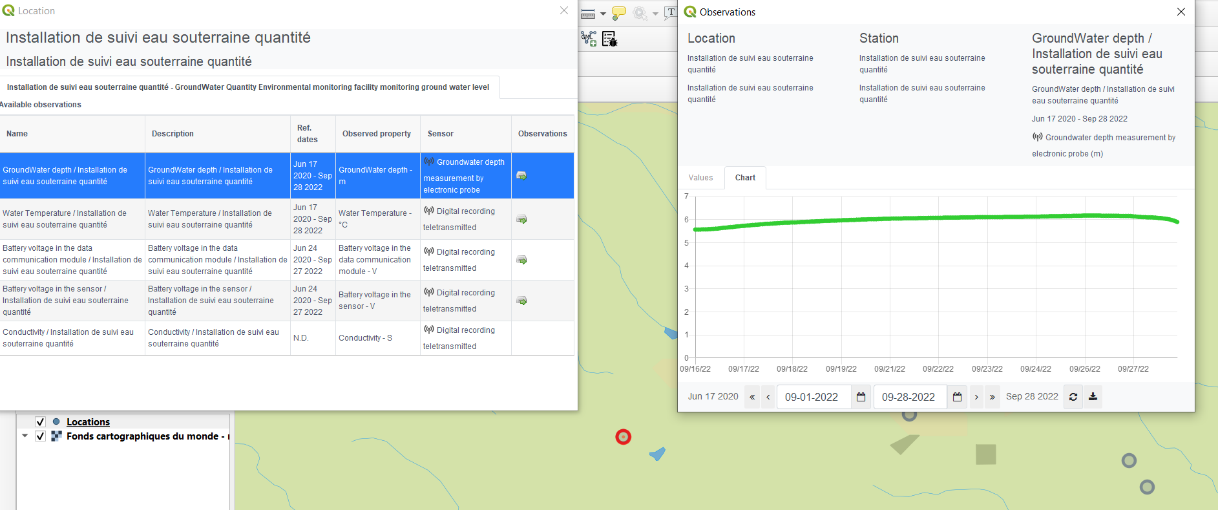
Same endpoint: different viewer
QGIS new ST API plugin

Slide 8
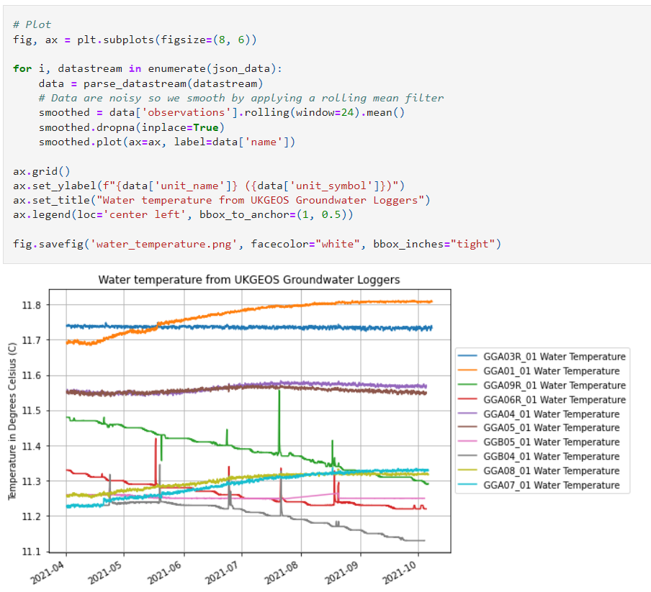
Non related examples
https://github.com/BritishGeologicalSurvey/sensor-things-api-demo/blob/main/sensor-things-api-demo.ipynb

